Slide 1
Deep Learning
DSBA 6156
Aziz Isamedinov

Slide 2
Agenda
What is Artificial Neural Networks?
Historical background
Commonly used Neural Networks in AI
ANN vs Deep Learning structure
How Does Neural Networks work?
Weaknesses and Strengths
Build the DNN classifier using Keras
Notes:
[1] Sec. 5.3, pg 10 https://arxiv.org/pdf/1404.7828.pdf
[2] https://link.springer.com/article/10.1007/BF00344251
[3] Sec. 5.4, pg 10 https://arxiv.org/pdf/1404.7828.pdf

Slide 3
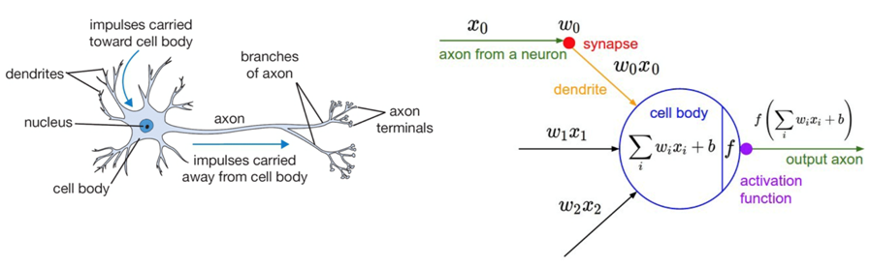
What is Artificial Neural Networks?
The development of neural nets were inspired by the arrangement
of neurons in the human brain.
Nodes through which data and computations flow
Receive one or more input signals
Perform some calculations
Send some output signals to neurons deeper in the neural net through a synapse

Slide 4
History of Neural Networks
1965 → Deep Networks based on Group Method of Data Handling (GMDH)
Soviet mathematicians Alexey G. Ivakhenko and V.G. Lapa created small, functional neural networks
Used Polynomial functions to grow layers and train analysis, then prune with validation set; later describing 8 layer network in 1971 [1]
1979 → First Artificial Neural Network: Neocognitron
Japanese computer scientist Kunihiko Fukushima developed a hierarchical network model of visual pattern recognition, the first type of “convolutional neural network”
Resembles modern architecture of many deep learning models that include his ideas of convolutional and downsampling layers [3]
1986→ Backpropagation: Theory
Rumelhart, Hinton, and Williams showed how backpropagation could improve neural networks [4]
Geoffrey Hinton, considered the “Godfather of Deep Learning” currently manages the Google Brain Team [5]
1989 → Backpropagation: Practice Use & Application
Yann LeCun (now the Chief AI scientist at Facebook[7]) demonstrated the first practical use for backpropagation, applying it and a CNN onto read “handwritten” digits to recognize handwritten ZIP codes on mail [6]
Backpropagation improved the accuracy of predictions in neural networks [8]
Notes:
[1] Sec. 5.3, pg 10 https://arxiv.org/pdf/1404.7828.pdf
[2] https://link.springer.com/article/10.1007/BF00344251
[3] Sec. 5.4, pg 10 https://arxiv.org/pdf/1404.7828.pdf

Slide 5
History of Neural Networks
1997 → Long short-term Memory (LTSM)
Type of recurrent neural network architecture, especially in speech and text [9]
Later used by Google Translate and Facebook translations
2006 → Hinton coins the term “Deep Learning”
Hinton published ”A fast learning algorithm for deep belief nets” stacking neural networks in layers [10]
Once too slow, pre-training each layer became much more efficient
2009→ ImageNet
Stanford professor Fei-Fei Li launches ImageNet, a database of 14 million images [11]
Became the benchmark for visual object recognition software research and use
2012 → Google’s Artificial Brain
Jeff Dean and Andrew Ng train a neural network on videos that can identify “significant objects” [12]
Not just for facial recognition, neural networks could learn objects
Notes:
[1] Sec. 5.3, pg 10 https://arxiv.org/pdf/1404.7828.pdf
[2] https://link.springer.com/article/10.1007/BF00344251
[3] Sec. 5.4, pg 10 https://arxiv.org/pdf/1404.7828.pdf

Slide 6
Commonly used Neural Networks in AI
ANN: Artificial Neural Networks
CNN: Convolutional Neural Networks
RNN: Recurrent Neural Networks
DNN: Deep Neural Networks
DBN: Deep Brief Networks
Various deep learning architectures such as DNN, Convolutional DNN, DBN and RRN have been applied to fields like computer vision, speech recognition, NLP, audio and bioinformatics where they have been shown to produce the state of of the art results on various tasks

Slide 7
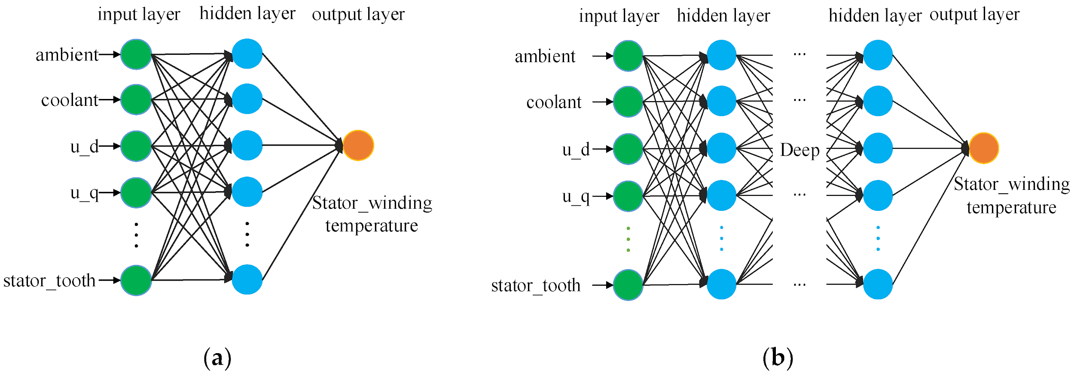
ANN and DNN Structures
Neural Networks are just layer of neurons connected together:
(a) A simple example of an ANN
(b) A DNN has two or more hidden layers.

Slide 8
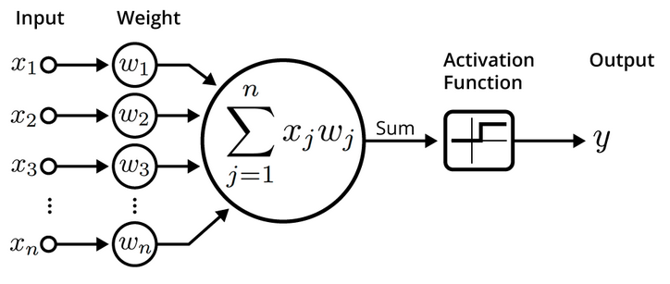
How does Neural Networks work?
Neurons are kinda/sorta similar to logistic regression
Iteratively process a set of training tuples & compare the network's prediction with the actual known target value.
For each training tuple, the weights are modified to minimize the mean squared error between the network's prediction and the actual target value.

Slide 9
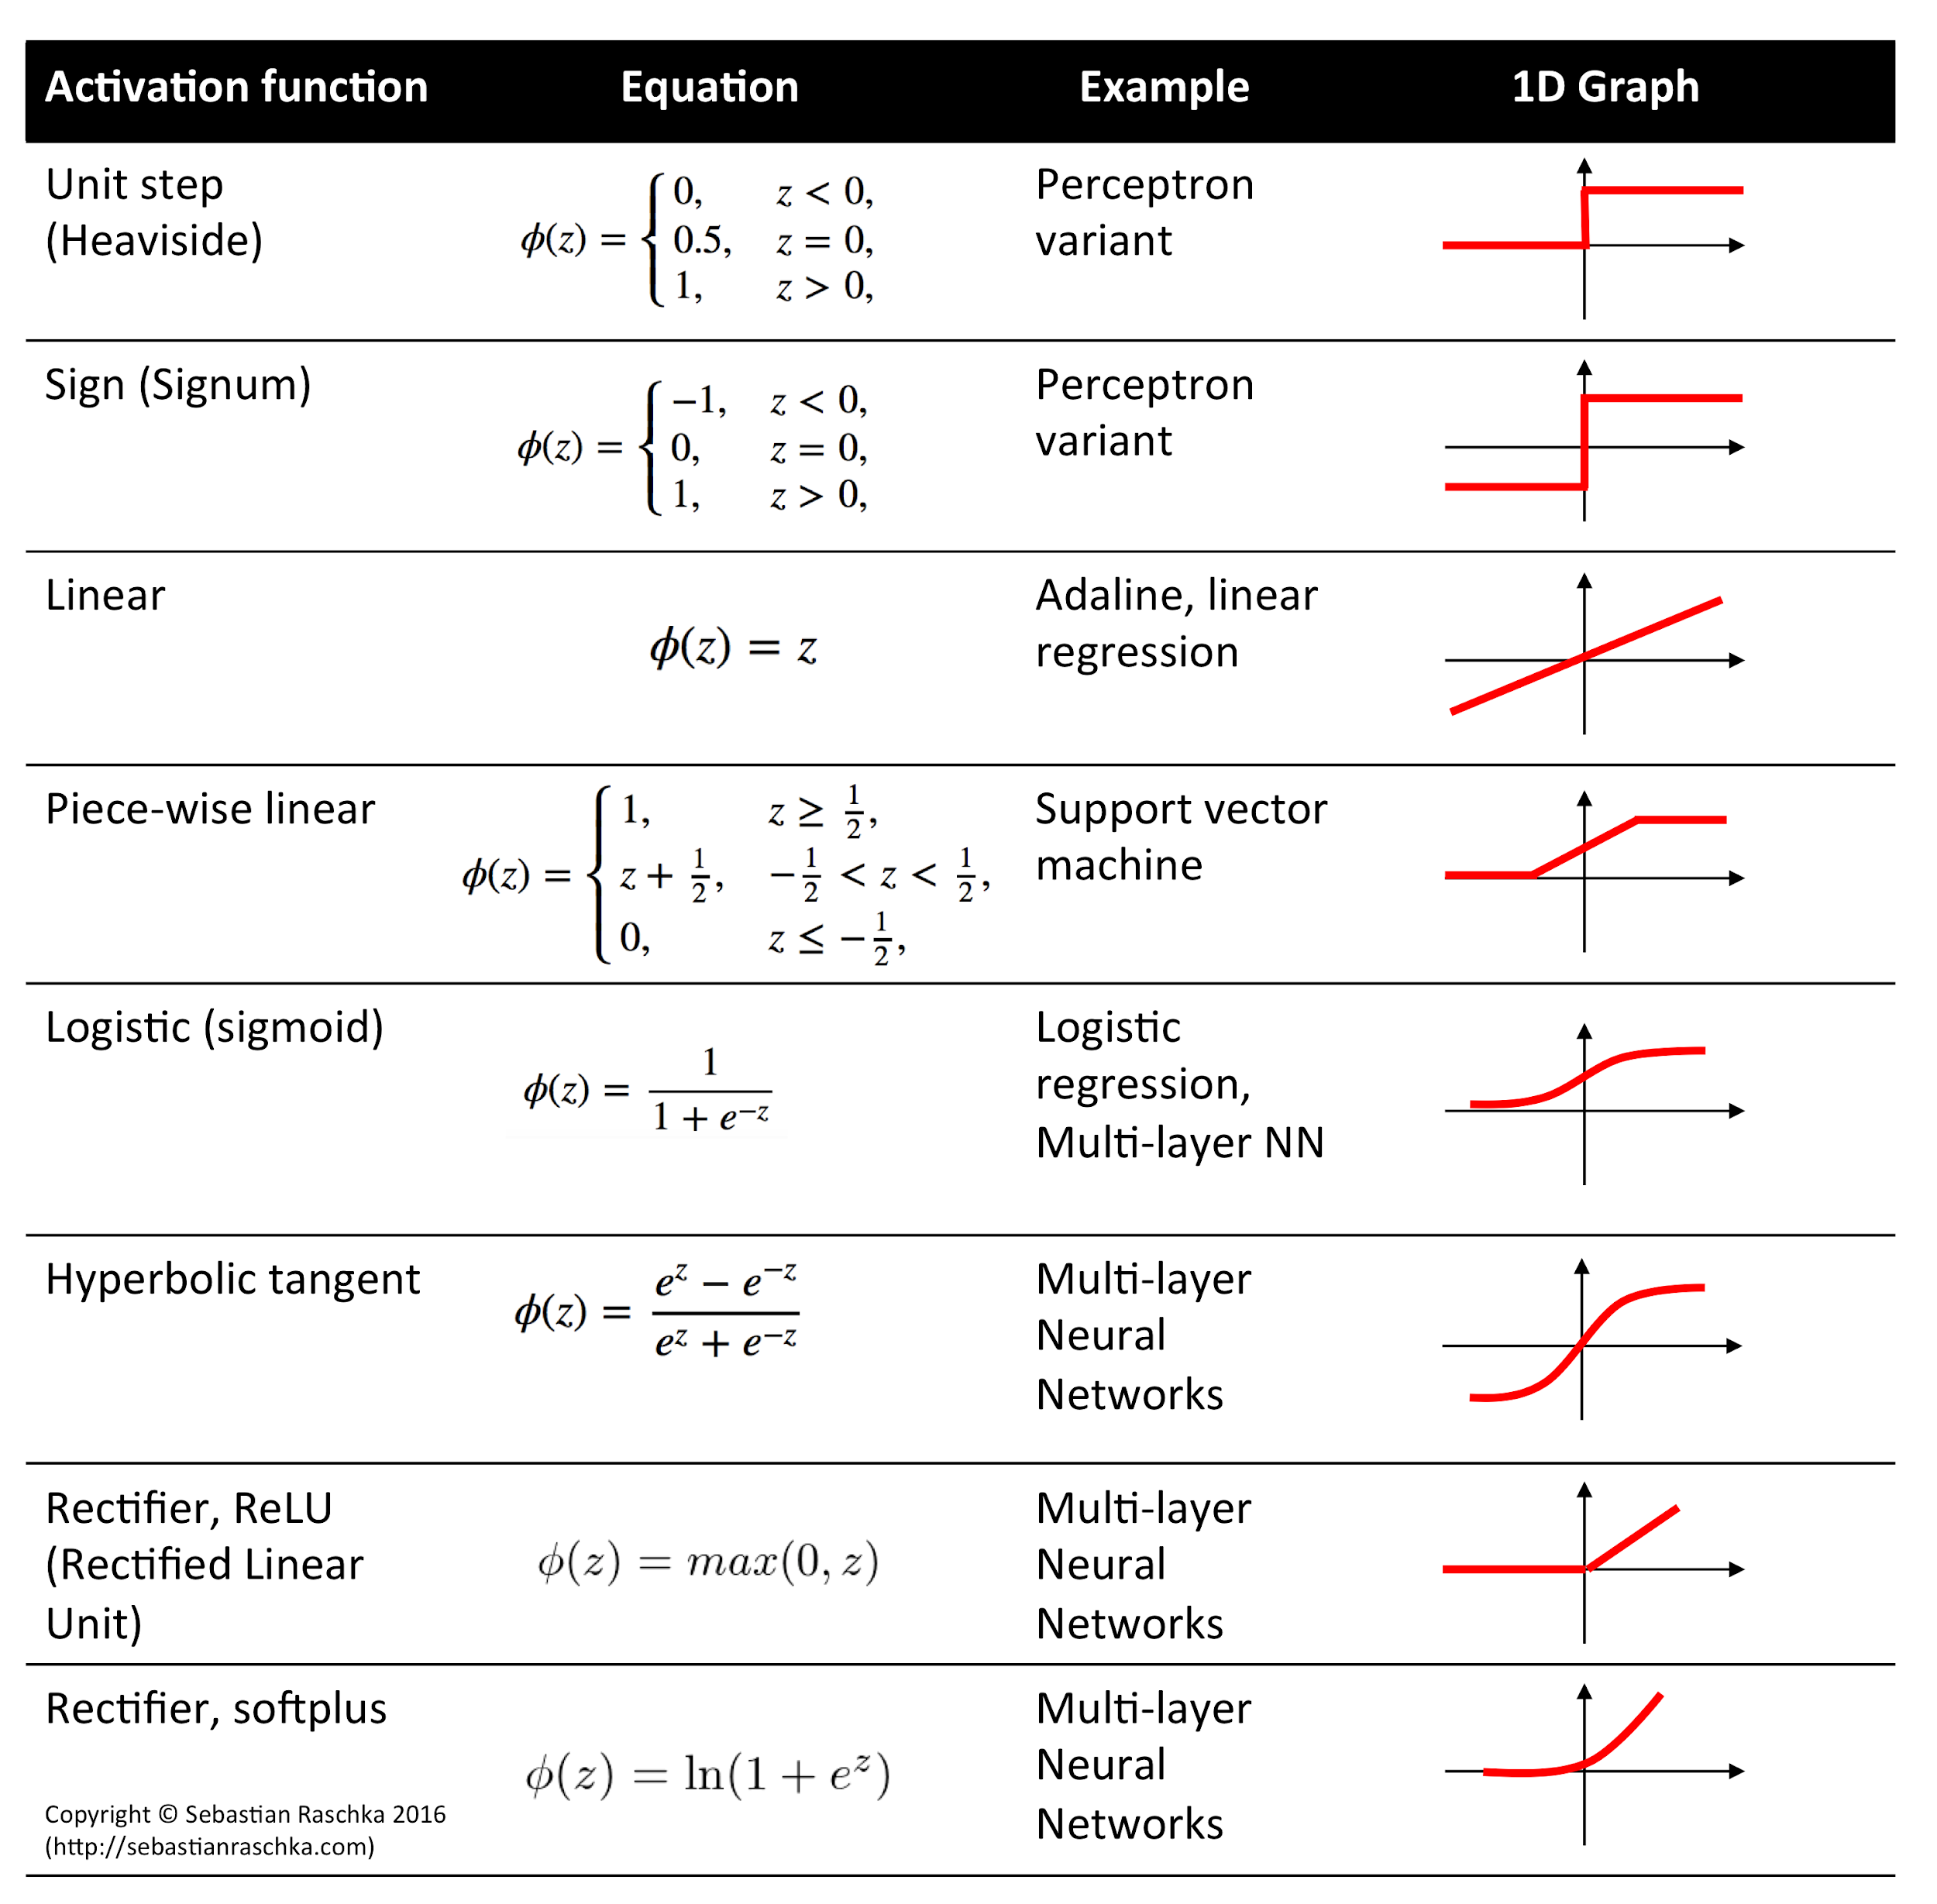
Activation Functions
•Activation Functions are applied to every node in a neural network.
•These functions decide whether or not a neuron should be activated.

Slide 10
Weaknesses and Strength of DNN
Weakness:
Long training time
Require a number of parameters typically best determined empirically, e.g., the network topology or “structure”.
Poor interpretability
Strength:
High tolerance to noisy data
Ability to classify untrained patterns
Well-suited for continuous-valued inputs and outputs
Successful on an array of real-world data, e.g., hand-written letters
Algorithms are inherently parallel
Techniques have recently been developed for the extraction of rules from trained neural networks

Slide 11




Build the DNN classifier using Keras
Analysis Objectives:
Detecting loan default using deep learning technique
Building KerasClassifier DNN model.
Performing Grid search using scikit-learn.
Reducing Overfitting using dropout regularization.
Cross validation(Kfold) and finding Optimal hyperparameters.
Generating Predictions using optimal deep learning model.
Tools:
Keras - it allows interaction with TensorFlow through a simplified interface similar to Sklearn
[Sequential Model -> KerasClassifier-> Fit -> Predict (with a few other steps)]
Scikit-learn - It is a machine learning library for the Python programming language.
Dataset: LendingClub dataset with 16k observations and balanced using upsampling method
Environment: Azure Cloud Compute Engine 2xTesla-GPU 112GB RAM

Slide 12
Steps to perform a Grid Search using sklearn
Steps | Parameter description | Param Values | Output
1.Find Optimal batch size and number of epochs | batch size : Number of samples per gradient update epochs: An epoch is an iteration over the entire x and y data provided. | batch_size = [2, 4, 8,16, 24, 32,64] epochs = [50, 100,150,200,300] | batch_size = 64 epochs = 150
2. Find optimal learning rate and dropout rate | learning_rate: the step size at each iteration while moving toward a minimum of a loss function dropout_rate: used for regularization,It is a fraction of the input units to drop. | learn_rate = [0.001, 0.01, 0.1] dropout_rate = [0.0, 0.1, 0.2] | learn_rate = 0.01 dropout_rate = 0.1
3.Find Optimal kernel initialization and activation functions | Activation: functions help generate output values within an acceptable range Init: define the way to set the initial random weights of Keras layers | activation = ['softmax', 'relu', 'tanh', 'linear'] init = ['uniform', 'normal', 'zero'] | activation= ‘tanh’ init = ‘'uniform'
4.Find the optimal number of neurons in each hidden layer | Neurons: intermediate hidden layer of DNN, The connections between nodes of adjacent layers have “weights” associated with them. | neuron1 = [4,8,16,32,64,72] neuron2 = [2,4,8,16,32,64] | neuron1 =72 neuron2 =64
5.Train the best model with more epochs | Optimized model | epochs = 3000 (training took 5 mins) | Improvement in accuracy after tuning, it went up from 0.60 to 0.82

Slide 13
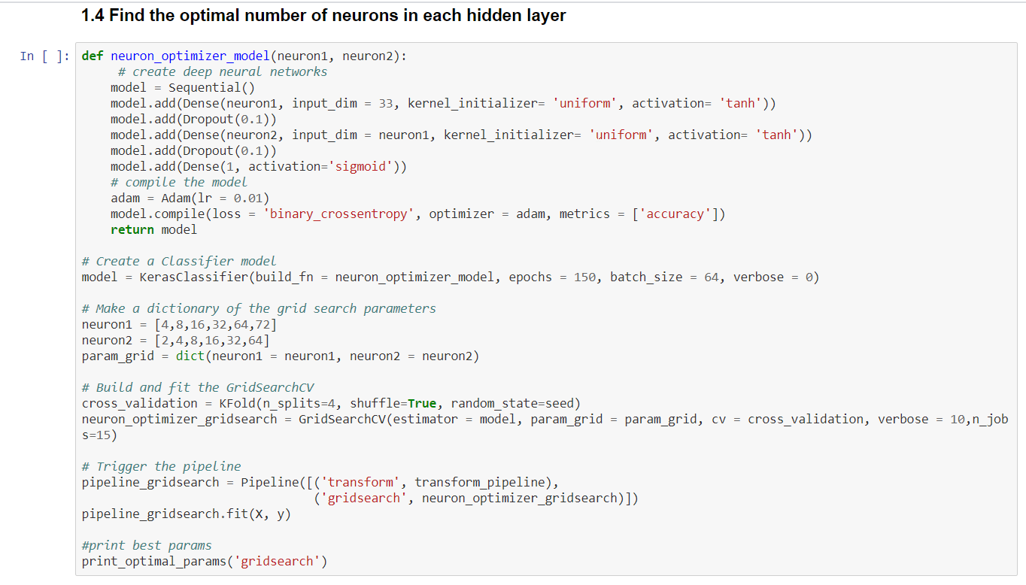
Notebook example

Slide 14
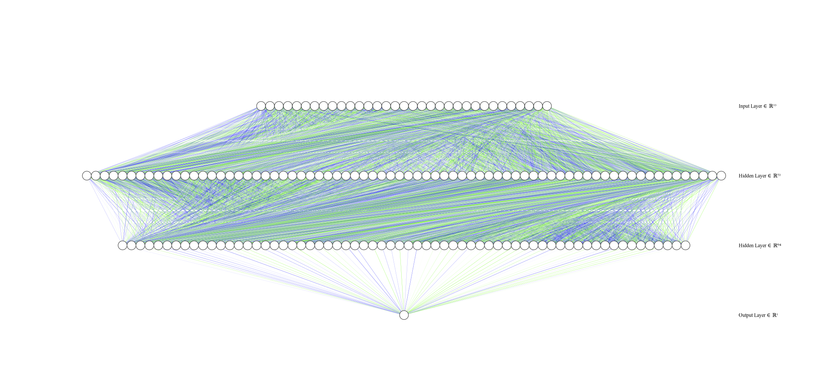
Optimized Deep Learning model structure
Input layer: 33(features) + Hidden layer1: 72(neurons) +Hidden layer2: 64(neurons) + Ouput layer: 1

Slide 15
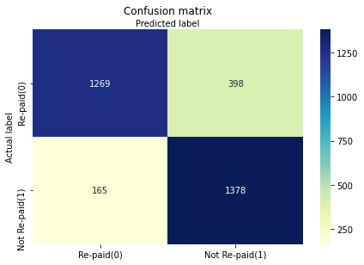
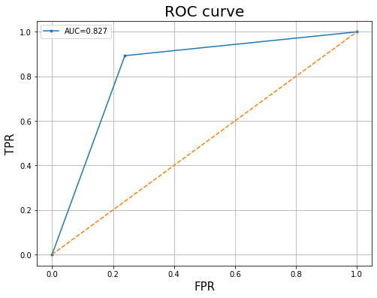
Evaluation Results
Accuracy = 0.8246 & Avg f1-score = 0.820 AUC = 0.827

Slide 16
Conclusion
Few points:
‘Deep Learning’ means using a neural network with several layers of nodes between input and output.
Networks with 1 hidden layer are not good at learning the weights for networks with more hidden layers.
Deep Learning algorithm maybe be more accurate in prediction than other machine learning algorithms, when it is properly designed and optimized.
There are so many types of DeepLearning
References:
Neural Networks:
https://www.explainthatstuff.com/introduction-to-neural-networks.html
Deeplearning with Keras & GridSearch:
https://machinelearningmastery.com/grid-search-hyperparameters-deep-learning-models-python-keras/
"Dropout: a simple way to prevent neural networks from overfitting:
https://jmlr.org/papers/volume15/srivastava14a/srivastava14a.pdf

